Slide 1
Capstone Project Report
Predicting the Suitable Locations for opening Indian Restaurant in Manhattan Neighbourhoods
13 Feb 2020
By : Rajan Bhatia

Slide 2
Predicting locations for starting new restaurant business is valuable for Entrprenuers
Starting new restaurant needs proper due diligence as the success of business depends on multiple factors
Neighbourhood and surrounding venues play important part in the decision about potential locations
Analysis of locations where such business is running successfully is important, that can help in identifying target locations

Slide 3
Data acquisition and cleaning
There are two data sources that have been utilised for the project :
a)The Borough and Neighbourhood Data (https://cocl.us/new_york_dataset)
b)The Venues data from FourSquare
The Neighbourhood data contained data for many Boroughs. From this, the neighbourhoods of Manhattan were filtered so that we could focus on its neighbourhoods.
The venues were fetched from FourSquare website, within the distance range of 500m, with a limit of 100 venues.
Extracted the venue categories from the data. The data for neighbourhoods and venues were combined.
The venue categories were converted in columns and measure of frequency of each category was taken for each neighbourhood. Onehot encoding was done and means were calculated.

Slide 4
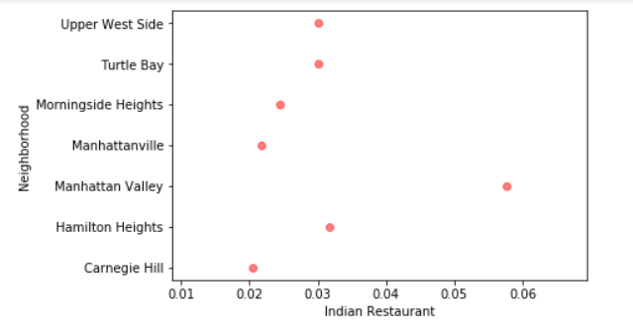
Identification of the existing Neighbourhoods that have Indian Restaurants

Slide 5
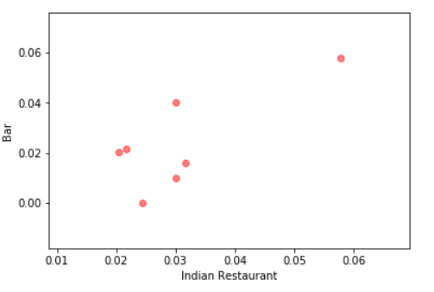
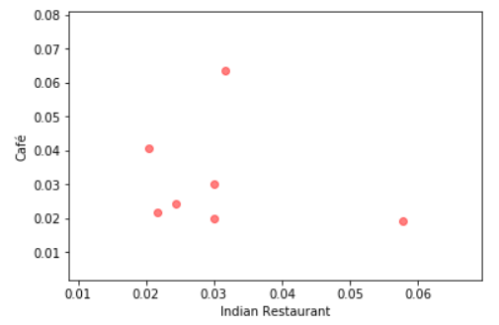
Important Venues that have been found near Indian Restaurants ...

Slide 6
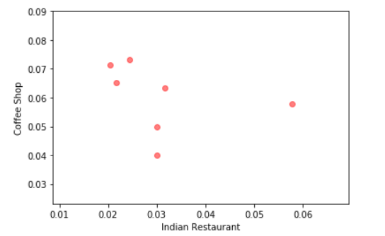
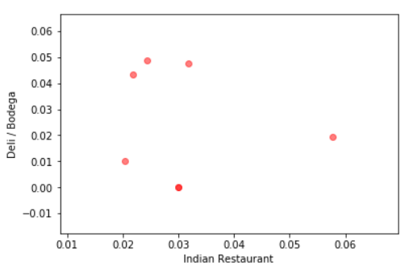
Important Venues that have been found near Indian Restaurants ...

Slide 7
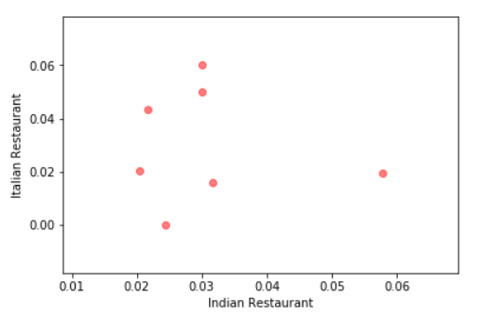
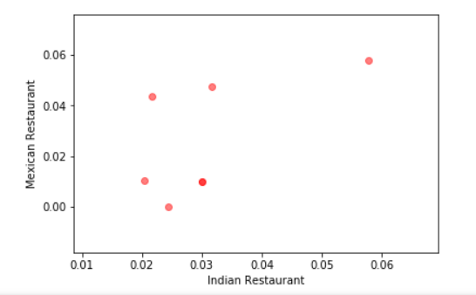
Important Venues that have been found near Indian Restaurants ...

Slide 8
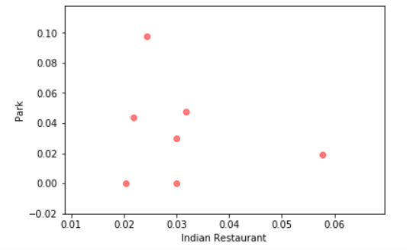
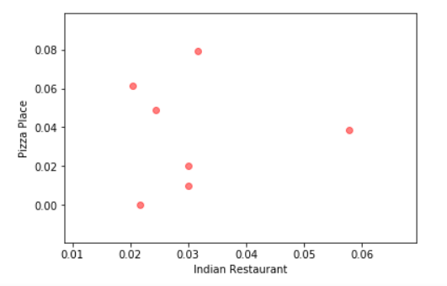
Important Venues that have been found near Indian Restaurants ...

Slide 9
Predictive Modelling
Classification model was used to predict the possibilities of setting up Indian Restaurants in the neighbourhoods. In the assignment,
* The data set is filtered where Indian Restaurants are present (Mean !=0)
* Test data is set to 20%, Train data is set to 80%
* The model is trained for K = 1 to 10
* Model is tested on Test data, and accurany score is calculated
K=10, is taken as the chosen best score for actual prediction on the remaining data set (Indian Restaurant mean = 0)
Tudor City and Inwood were found to be the closest match with the neighbourhoods that had similar venues where Indian Restaurants are doing business.

Slide 10
Conclusion and future directions
Built useful model to predict potential locations to start new Indian Restaurant
Tudor City and Inwood were found to be the closest match with the neighbourhoods that had similar venues where Indian Restaurants are doing business.
Also there are other factors like Ethnic spread of population residing in the neighbourhoods that could influence the selection of location.

